Slide 1

MICROMOUTH MARVELS
04/04/2024
The Influence of Probiotic Mouthwash on Genomic Profiles and Health of the Oral Human Microbiome
Delinyah Koning, Jetske van Kampen, Maryam Esmaeli, Lily Gyammerah, Dipto Gosswami
Notes:
Delinyah

Slide 2

Content
Introduction on the oral microbiome
Objective and Hypothesis
Methods of Research & Data Collection/Processing
Dashboard Presentation
MICROMOUTH MARVELS
04/04/2024
Notes:
Delinyah

Slide 3

04/04/2024
Introduction
— PART 1
MICROMOUTH MARVELS
Notes:
Delinyah

Slide 4


MICROMOUTH MARVELS
04/04/2024
Microbiome = community of microorganisms
Many people believe that a healthy oral cavity means no bacteria
In fact, the oral cavity contains ~700 prokaryotic species across 12 phyla
Unique microbial diversity
Individually
Site-dependent
The oral microbiome
WHAT MANY PEOPLE DO NOT KNOW
4
Notes:
Delinyah

Slide 5
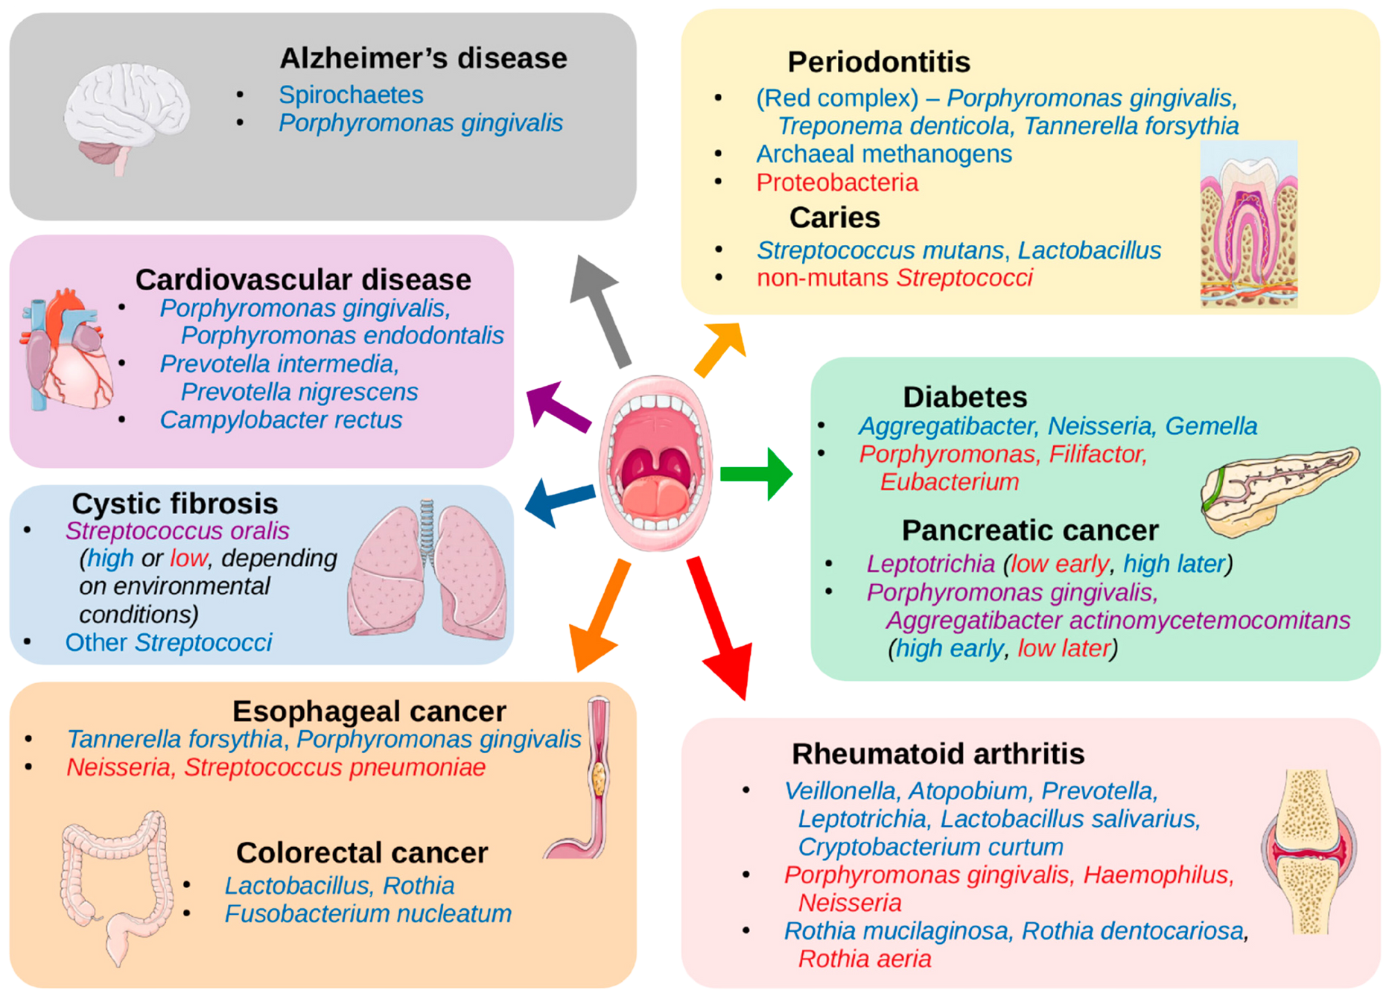
5
MICROMOUTH MARVELS
04/04/2024
Notes:
Delinyah

Slide 6
MICROMOUTH MARVELS
04/04/2024
Oral Health
maintenance and measures
General oral health care
Brushing the teeth, flossing, using mouth wash, regular dentist visits
Secondary measures
Diet-related, immune system-related, medicine-intake, etc.
6
Notes:
Delinyah

Slide 7
Oral Probiotics Containing
01
produce antimicrobial substances
02
maintain acidic environments
03
prevent biofilm formation of pathogenic species and prevent their adherence to teeth and mucosal surfaces
Lactobacillus
7
MICROMOUTH MARVELS
04/04/2024
Notes:
Delinyah

Slide 8
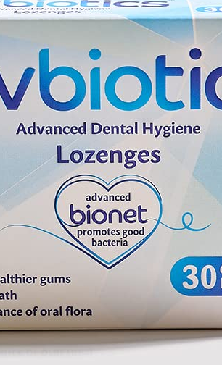
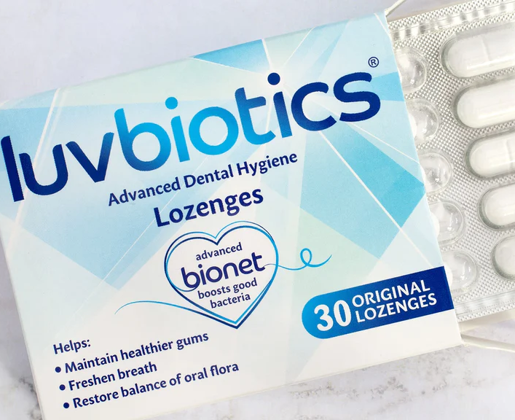
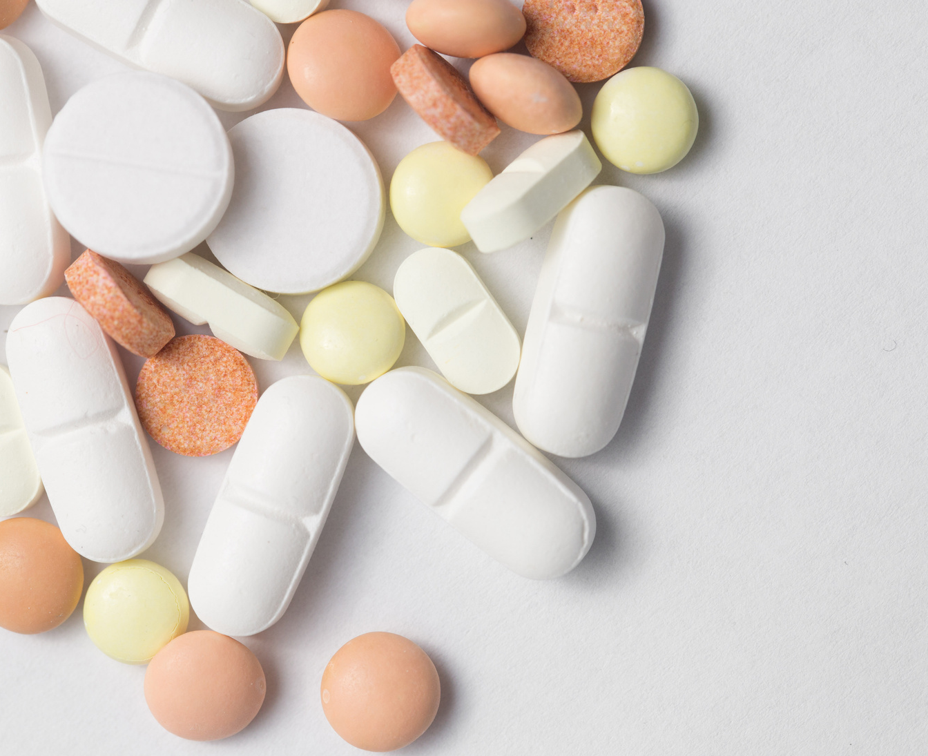
LuvBiotics
Blend of 16 live cultures, with Lactobacillus reuteri most prevalent
Claims to improve oral health
‘Bionet’ technology to promote growth of beneficial bacteria
8
Notes:
Delinyah

Slide 9

MICROMOUTH MARVELS
04/04/2024
Objective
Hypothesis
WHAT WE WANT TO STUDY
WHAT WE EXPECT
Assess effectiveness of LuvBiotics after a 4-week administration phase of one pill per day, in the evening.
Reduction in gum bleeding prevalence.
Decrease in tooth plaque accumulation.
Maintenance of normal salivary pH levels.
Positive shift in microbiome composition
9
Notes:
Delinyah

Slide 10

Positive shift in microbiome composition
BY MEANS OF 16S DNA SEQUENCING
Increase in relative abundance of beneficial species, such as Lactobacillus species.
Decreased relative abundance of pathogenic species, such as Streptococcus mutans & Porphyromonas gingivalis.
10
MICROMOUTH MARVELS
04/04/2024
Notes:
Delinyah

Slide 11
04/04/2024
Methodology
— PART 2
MICROMOUTH MARVELS
Notes:
Maryam

Slide 12
PHASE 1
Literature research, project planning
Research Timeline
PHASE 2
Baseline period (two weeks)
PHASE 3
Administration phase (four weeks)
PHASE 4
Data collection and processing
11
MICROMOUTH MARVELS
04/04/2024
Notes:
Maryam

Slide 13
Measurements
PERFORMED IN BASELINE AND ADMINISTRATION PHASE
Frequency of
gum bleeding
(every day)
Prevalence
of teeth
with plaque
(twice a week)
Salivary
PH
(3 times a week)
Microbiome
Profile
(after baseline, after trial)
yes/no
Disclosing tablet, counting
pH strips with .3 increments
lab work
12
MICROMOUTH MARVELS
04/04/2024
Notes:
Maryam

Slide 14
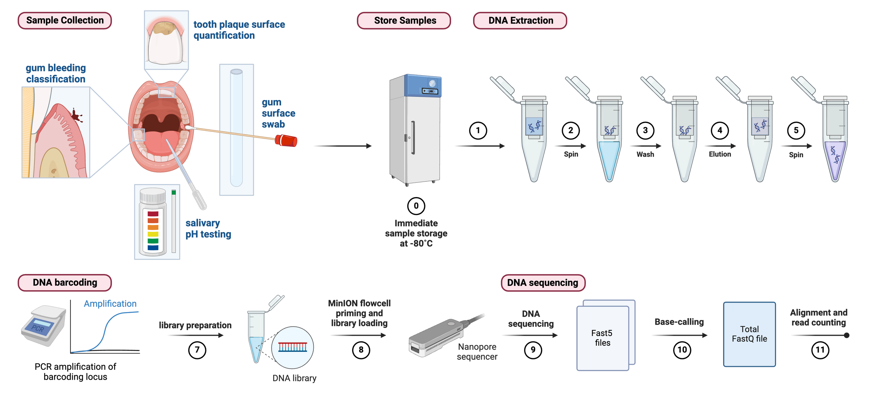
MICROMOUTH MARVELS
04/04/2024
13
Notes:
Maryam

Slide 15

MICROMOUTH MARVELS
04/04/2024
Variables to consider
Unchanged factors
Existing diet
General oral hygiene
Smoking habits
Alcohol consumption
Physical features with natural diversity
Age
Gender
Saliva Flow
Oral pH
Immunocompetence
14
Notes:
Maryam

Slide 16
Data Collection
HOW OUR DATA WAS SAMPLED AND PROCESSED
STEP 1
STEP 2
STEP 3
Individual data input in an Excel file stored in an online Microsoft Teams environment
Data conversion to .csv files and using .yaml files to load the data into a Python environment for processing
Writing Python code to (statistically) analyse the data and to yield visualization (graphs and dashboard)
15
MICROMOUTH MARVELS
04/04/2024
Notes:
Maryam

Slide 17
04/04/2024
About the Sequencing
— INTERMEZZO
MICROMOUTH MARVELS
Notes:
Delinyah

Slide 18
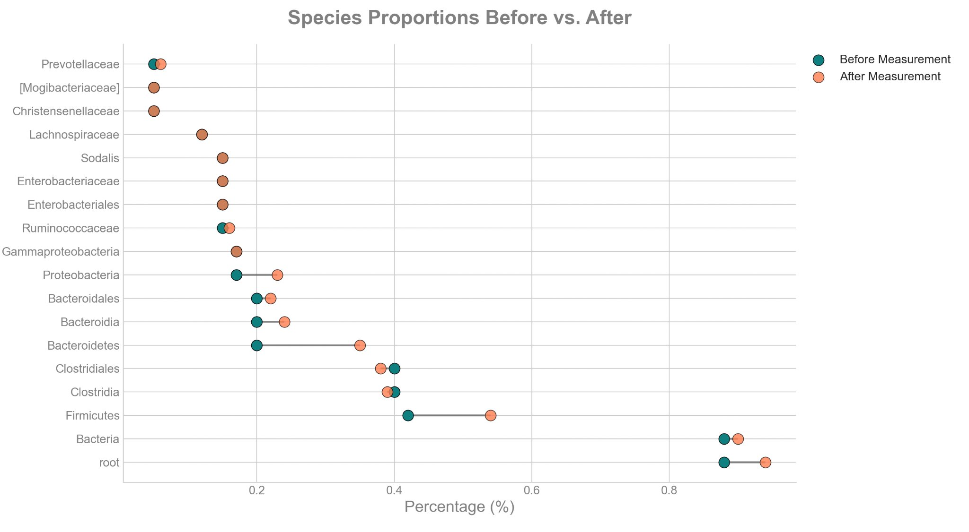
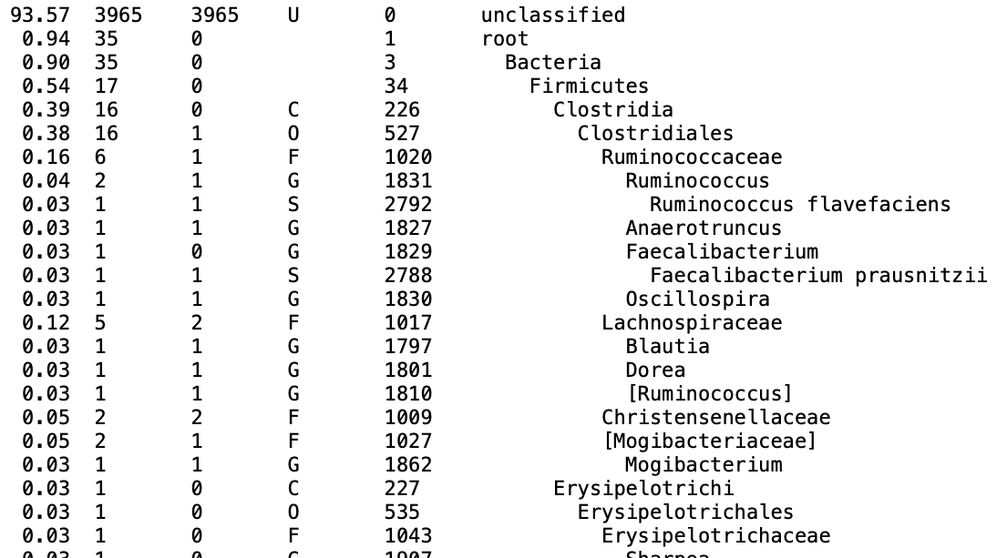
Generate KrakEN output
taxonomic assignment of metagenomics sequencing reads
Available code outputs summary file
Taxonomic differentiation
Number of reads and relative occurrence
Generate comparative graph
Input two files
Compares species proportion from two moments
Optionally handles top n results or species pre-selection
Works with KrakEN output and Bracken output
Generate BRACKEN output
statistical method that computes the abundance of species
Bayesian Reestimation of Abundance
with KrakEN (statistical method)
17
MICROMOUTH MARVELS
04/04/2024
Notes:
Delinyah

Slide 19

04/04/2024
Dashboard
— PART 4
MICROMOUTH MARVELS
Notes:
Jetske

Slide 20
04/04/2024
Statistics
— PART 5
MICROMOUTH MARVELS
Notes:
Jetske

Slide 21
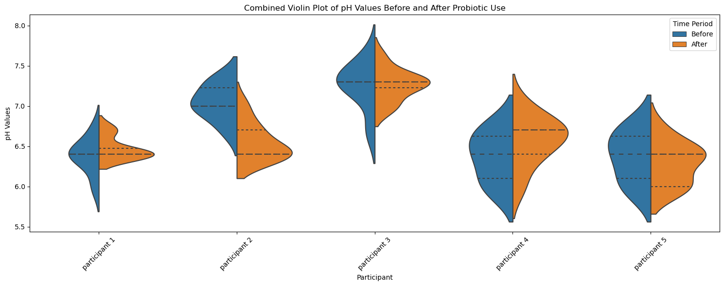
Statistics Ph values
Combined Violin plot

Slide 22
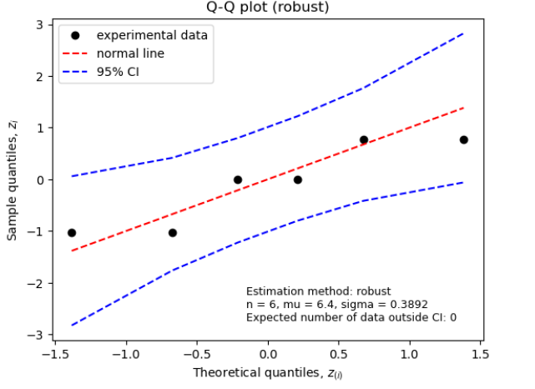
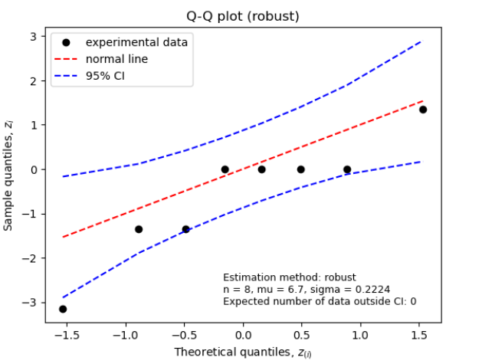
Statistics Ph values
QQ plots
Participant 1
Participant 2
Participant 3
Participant 4
Participant 5
Before:
N = 6 , mu= 6,4 , sigma =0
A: 0
After:
N = 8 , mu=6.4 , sigma = 0.0556
A: 0
Before:
N =6 , mu= 7 , sigma = 0.1688
A: 0
After:
N = 8 , mu= 6.4 , sigma =0.2224
A: 0
Before:
N = 6, mu=7.3 , sigma = 0
A: 0
After:
N = 8 , mu=7.3 , sigma = 0.556
A: 0
Before:
N = 6 , mu=6.4 , sigma = 0.3892
A: 0
After:
N =8, mu= 6.7, sigma = 0.224
A: 0
Before:
N =6 , mu=6.4 , sigma = 0.3892
A: 0
After:
N = 8, mu=6.4 , sigma = 0.2965
A: 0
A = Expected number of data outside CI:0

Slide 23
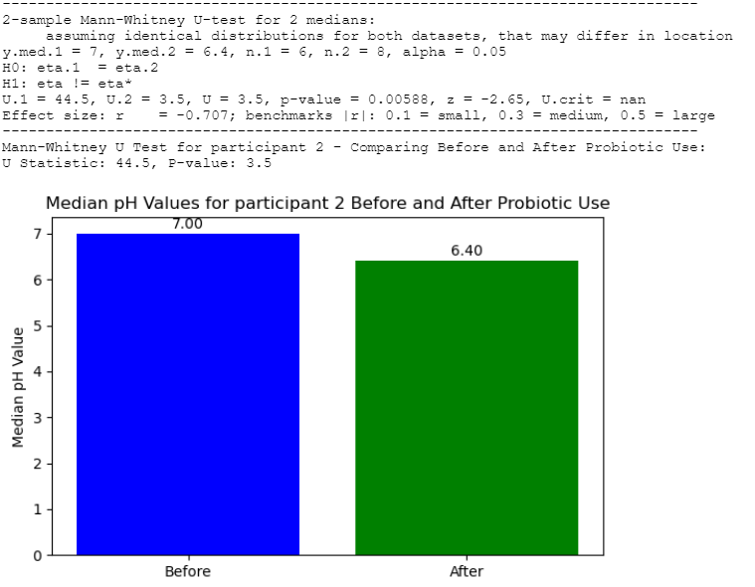
Statistics Ph values
2-sample Mann-Whitney U-test for 2 medians
Participant 1
No significant difference
P = 0.416
Participant 2
Significant difference
P = 0.00588
Participant 3
No significant difference
P = 0.821
Participant 4
No significant difference
0.219
Participant 5
No significant difference
0.58

Slide 24
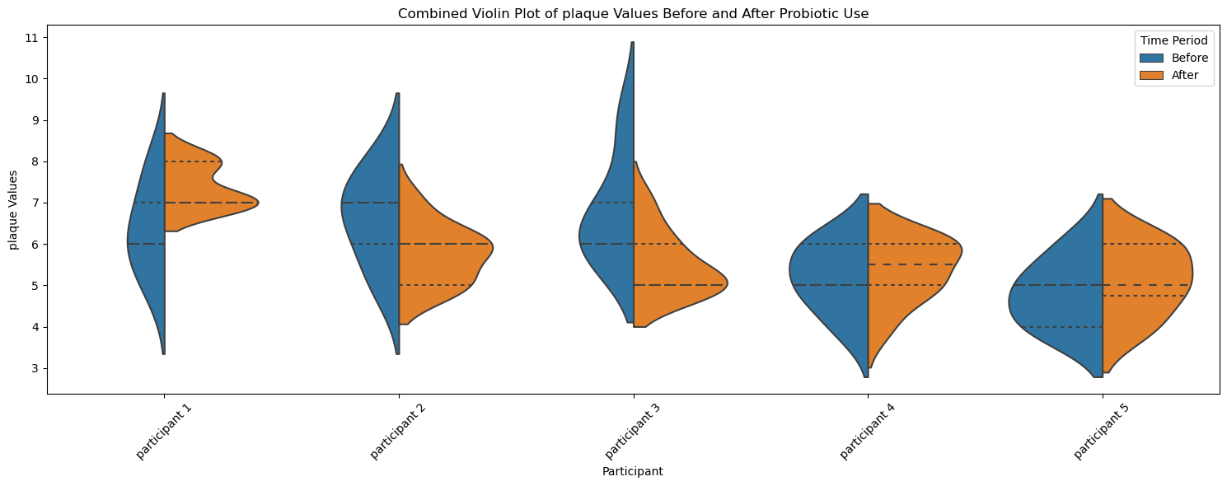
Statistics Amount of Tooth Plaque
Combined Violin plot

Slide 25
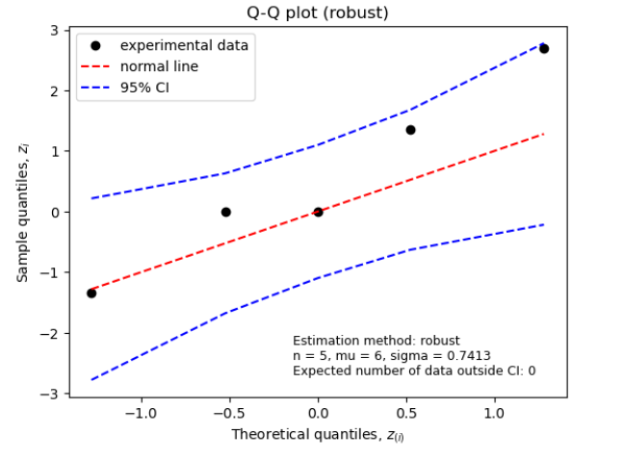
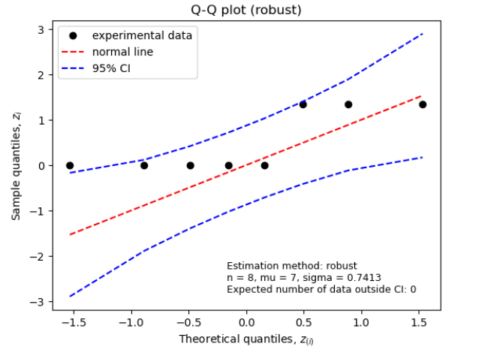
Statistics Tooth Plaque
QQ plots
Participant 1
Participant 2
Participant 3
Participant 4
Participant 5
Before:
N = 5 , mu= 6 , sigma =0.7413
A: 0
After:
N = 8 , mu=7.0, sigma = 0.7413
A: 0
Before:
N =5 , mu= 7 , sigma = 0.7413
A: 0
After:
N = 8 , mu= 6 , sigma =0.7413
A: 0
Before:
N = 5, mu=6 , sigma = 0.7413
A: 0
After:
N = 8 , mu=5 , sigma = 0.0.7413
A: 0
Before:
N = 5 , mu=5, sigma = 0.7413
A: 0
After:
N =8, mu= 5.5, sigma = 0.7413
A: 0
Before:
N =5 , mu=5 , sigma = 0.7413
A: 0
After:
N = 8, mu=5 , sigma = 0.9266
A: 0
A = Expected number of data outside CI:0

Slide 26
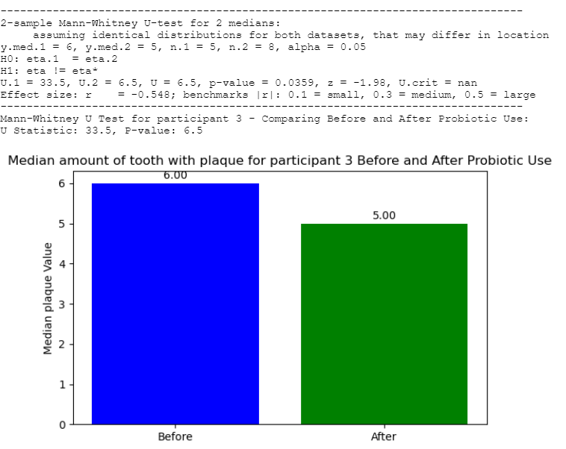
Statistics tooth plaque
2-sample Mann-Whitney U-test for 2 medians
Participant 1
No significant difference
P = 0.0849
Participant 2
No significant difference
P = 0.144
Participant 3
Significant difference
P = 0.0359
Participant 4
No significant difference
0.691
Participant 5
No significant difference
0.485

Slide 27
MICROMOUTH MARVELS
04/04/2024
Conclusion
INTERPRETATION OF OUR RESULTS
Discussion
Gum bleeding
No significant differences
Tooth plaque
1 significant difference
Salivary pH
1 significant difference
TROUBLESHOOTING
Plaque sampling method
Sample size
Duration of administration
Little continuous data
Statistics require update
19
Notes:
Jetske

Slide 28

Notes:
Jetske

